Slide 1


SAHEEL NITHOO
26/10/2025

Slide 2

Outline
Executive Summary
Introduction
Methodology
Results
Conclusion
Appendix

Slide 3
Executive Summary
This capstone project focuses on predicting the successful landing of SpaceX Falcon 9 first-stage rockets through multiple machine learning classification techniques.
Based on the comparative performance of various algorithms, Logistic Regression, SVM and KNeighborsClassifier emerge as the best effective models for forecasting Falcon 9 first-stage landing success with each algorithm giving an accuracy of 83%.

Slide 4
Introduction
• In this capstone, we will predict if the Falcon 9 first stage will land successfully. SpaceX advertises Falcon 9 rocket launches on its website with a cost of 62 million dollars; other providers cost upward of 165 million dollars each, much of the savings is because SpaceX can reuse the first stage. Therefore, if we can determine if the first stage will land, we can determine the cost of a launch. This information can be used if an alternate company wants to bid against SpaceX for a rocket launch.
• The main question that we are trying to answer is, for a given set of features about a Falcon 9 rocket launch which include its payload mass, orbit type, launch site, and so on, will the first stage of the rocket land successfully?

Slide 5

Section 1

Slide 6
Methodology
Executive Summary
Data collection methodology:
Use SpaceX API
Perform Web Scraping
Perform data wrangling
Use Training Labels(1 means booster successfully landed, 0 means it was unsuccessful.)
Perform exploratory data analysis (EDA) using visualization and SQL
Perform interactive visual analytics using Folium and Plotly Dash
Perform predictive analysis using classification models
How to build, tune, evaluate classification models

Slide 7
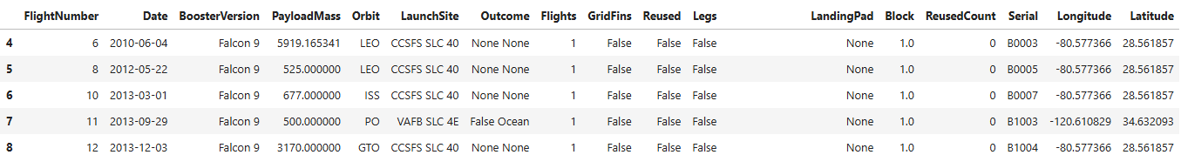
Data Collection – SpaceX API
• The API used is https://api.spacexdata.com/v4/rockets /.
• The API provides data about many types of rocket launches done by SpaceX; the data is therefore filtered to include only Falcon 9 launches.
• Every missing value in the data is replaced the mean the column that the missing value belongs to.
• We end up with 90 rows and 17 columns. The picture below shows the first few rows of the data:

Slide 8
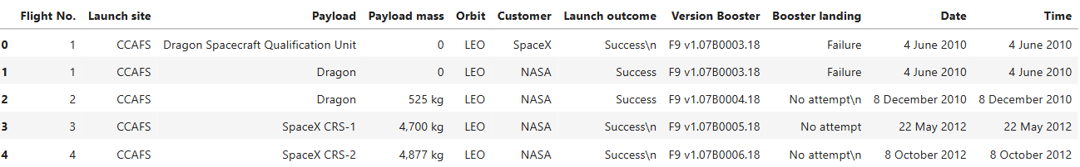
Data Collection - Scraping
• The data is scraped from https://en.wikipedia.org/wiki/List_of_Falcon_9_and_Falcon_Heavy_launches
• The website contains only the data about Falcon 9 launches.
• We end up with 121 rows or instances and 11 columns or features. The picture below shows the first few rows of the data:

Slide 9
EDA with Data Visualization
• Matplotlib and Seaborn
• Functions from the Matplotlib and Seaborn libraries are used to visualize the data through scatterplots, bar charts, and line charts
• Folium
• Functions from the Folium libraries are used to visualize the data through interactive maps.
• Dash
• Functions from Dash are used to generate an interactive site where we can toggle the input using a dropdown menu and a range slider.

Slide 10
EDA with SQL
• The data is queried using SQL to answer several questions about the data such as:
• The names of the unique launch sites in the space mission
• The total payload mass carried by boosters launched by NASA (CRS)
• The average payload mass carried by booster version F9 v1.1

Slide 11
Build an Interactive Map with Folium
• The Folium library is used to:
• Mark all launch sites on a map
• Mark the succeeded launches and failed launches for each site on the map
• Mark the distances between a launch site to its proximities such as the nearest city, railway, or highway

Slide 12
Build a Dashboard with Plotly Dash
• Functions from Dash are used to generate an interactive site.
• Using a pie chart and a scatterplot, the interactive site shows:
• The total success launches from each launch site
• The correlation between payload mass and mission outcome( success or failure) for each launch site

Slide 13
Predictive Analysis (Classification)
• Functions from the Scikit-learn library are used to create our machine learning models.
• The machine learning prediction phase include the following steps:
• Standardizing the data
• Splitting the data into training and test data
• Creating machine learning models
• Fit the models on the training set
• Find the best combination of hyperparameters for each model
• Evaluate the models based on their accuracy scores and confusion matrix

Slide 14
Results
• The results are split into 5 sections:
• SQL(EDA with SQL)
• Matplotlib and Seaborn (EDA with Visualization)
• Folium
• Dash
• Predictive Analysis
• In all of the graphs that follow, class 0 represents a failed launch outcome while class 1 represents a successful launch outcome

Slide 15

Section 2

Slide 16
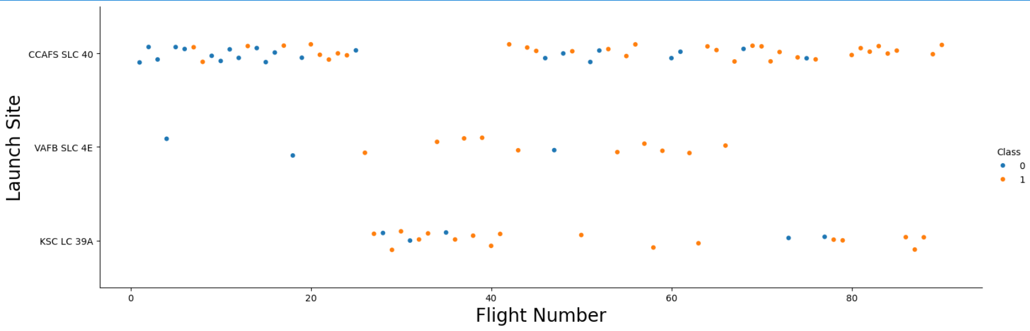
Flight Number vs. Launch Site
We can see that as flight number increases; the first stage is more likely to land successfully for each launch site

Slide 17
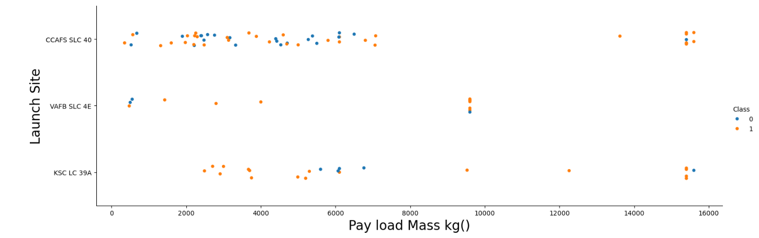
Payload vs. Launch Site
for the VAFB-SLC launchsite there are no rockets launched for heavy payload mass(greater than 10000).

Slide 18
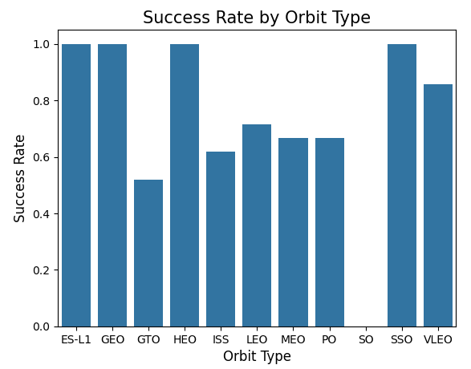
Success Rate vs. Orbit Type
ES-L1,GEO,HEO and SSO have the highest success rates.

Slide 19
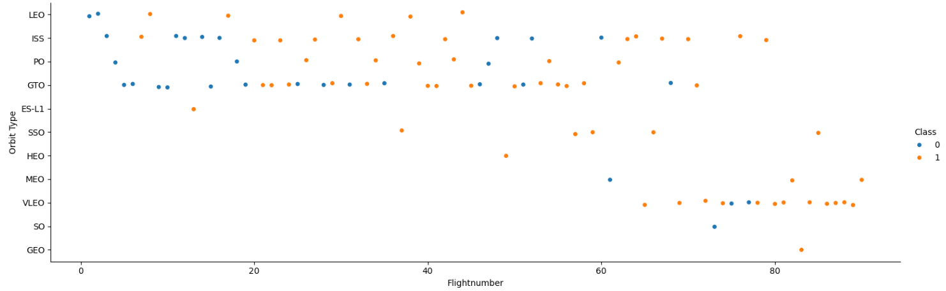
Flight Number vs. Orbit Type
In the LEO orbit, success seems to be related to the number of flights. Conversely, in the GTO orbit, there appears to be no relationship between flight number and success.

Slide 20
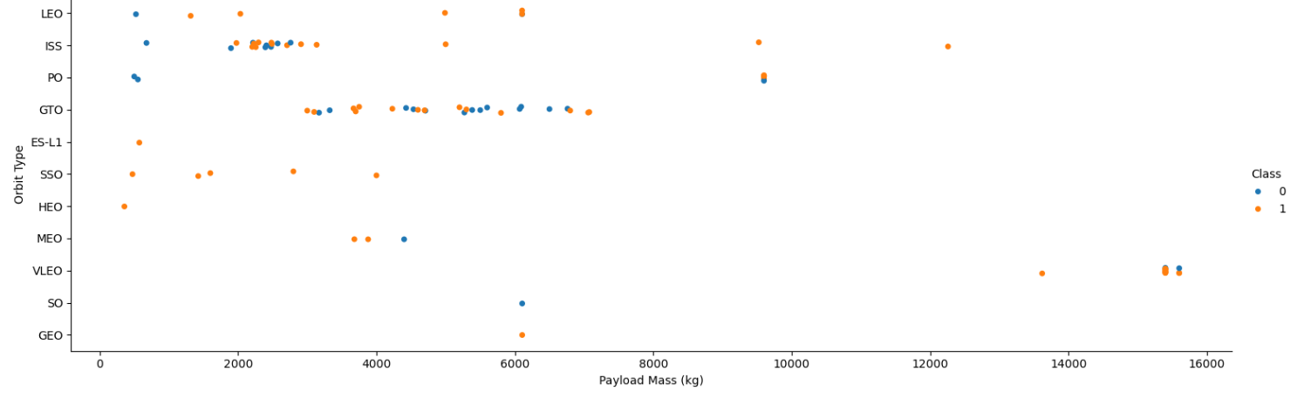
Payload vs. Orbit Type
With heavy payloads the successful landing or positive landing rate are more for Polar,LEO and ISS.
However, for GTO, it's difficult to distinguish between successful and unsuccessful landings as both outcomes are present

Slide 21
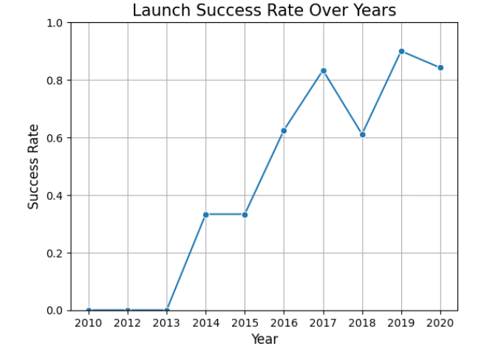
Launch Success Yearly Trend
you can observe that the success rate since 2013 kept increasing till 2020

Slide 22
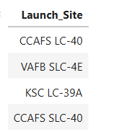
All Launch Site Names
Names of the unique launch sites in the space mission

Slide 23
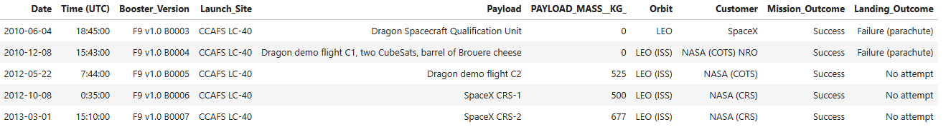
Launch Site Names Begin with 'CCA'

Slide 24
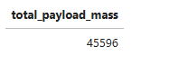
Total Payload Mass
The total payload mass amounts to 45596

Slide 25
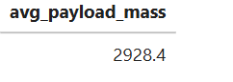
Average Payload Mass by F9 v1.1
average payload mass carried by booster version F9 v1.1= 2928.4

Slide 26
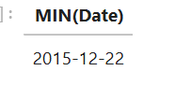
First Successful Ground Landing Date
dates of the first successful landing outcome on ground pad

Slide 27
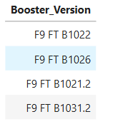
Successful Drone Ship Landing with Payload between 4000 and 6000
names of boosters which have successfully landed on drone ship and had payload mass greater than 4000 but less than 6000

Slide 28
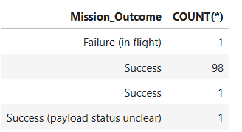
Total Number of Successful and Failure Mission Outcomes
the total number of successful and failure mission outcomes

Slide 29
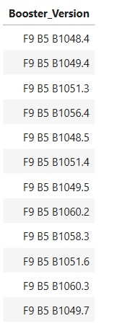
Boosters Carried Maximum Payload
names of the booster which have carried the maximum payload mass

Slide 30
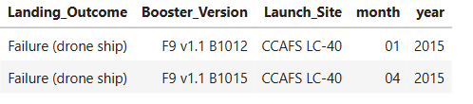
2015 Launch Records
failed landing_outcomes in drone ship, their booster versions, and launch site names for in year 2015

Slide 31
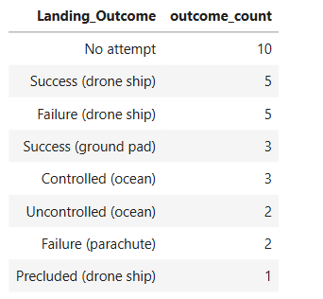
Rank Landing Outcomes Between 2010-06-04 and 2017-03-20
count of landing outcomes between the date 2010-06-04 and 2017-03-20

Slide 32

Section 3

Slide 33
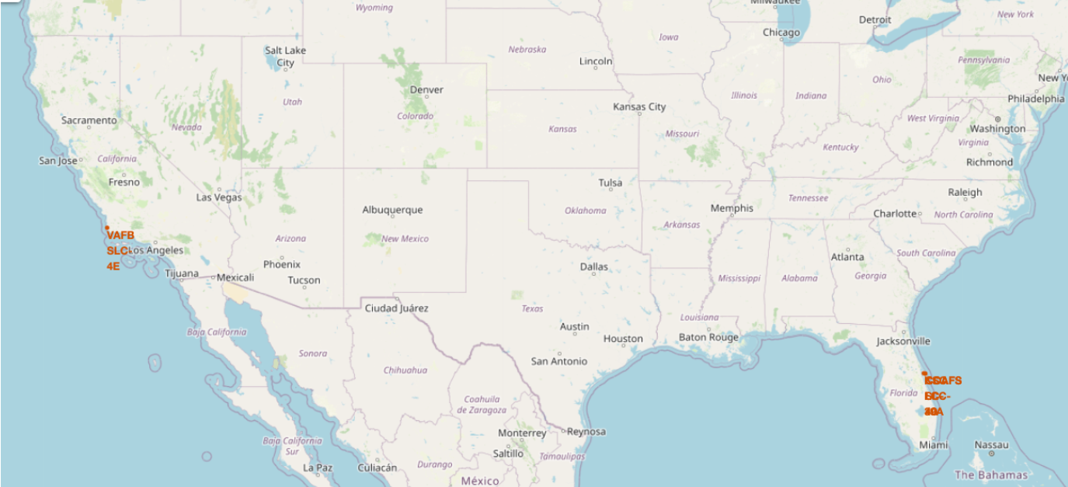
Launch Sites Location
all the launch sites are in proximity to the Equator line and near the coast

Slide 34
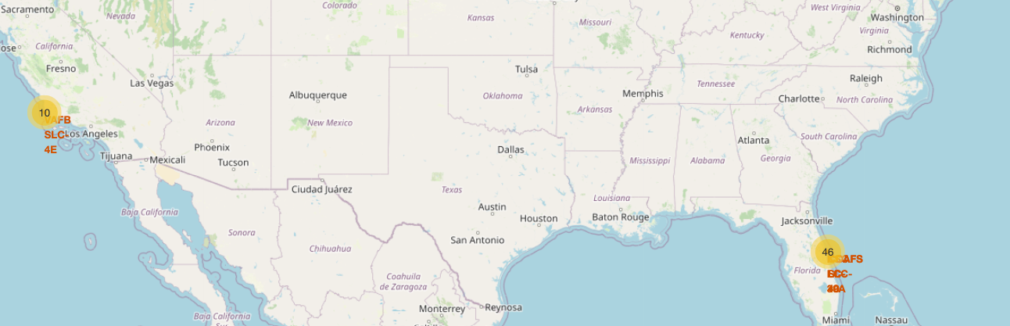
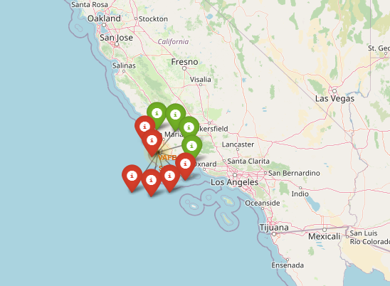
Success/failed launches for each site
Yellow icon represents number of launches
Green color represents successful launch and red color failed launch.

Slide 35
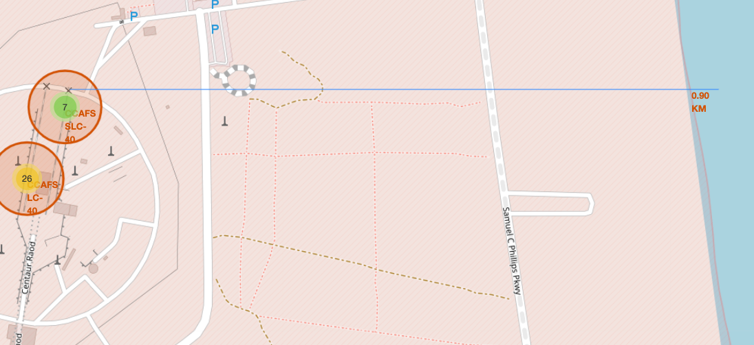
Distance between launch site and proximities

Slide 36

Section 4

Slide 37
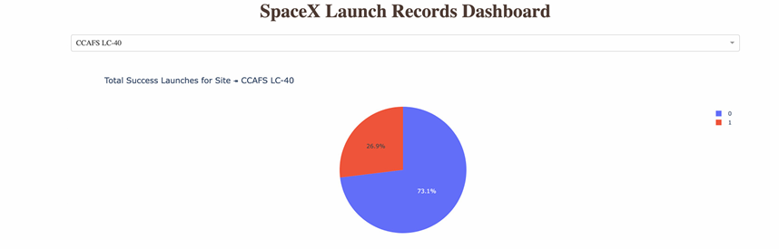
Launch success count for all sites
Blue color represents failed launches and red represents successful launches.
We can see that only 26.9% of CCAFS LC-40 launches are successful.

Slide 38
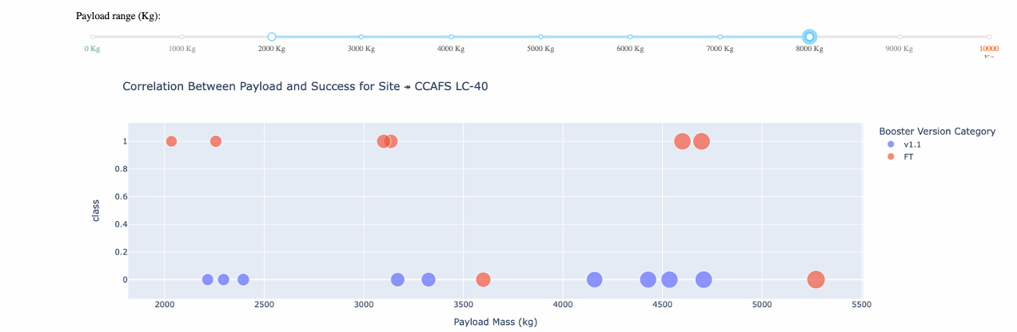
Payload vs. Launch Outcome
The picture shows a scatter plot where the payload range is set in the range 2000-8000kg

Slide 39

Section 5

Slide 40
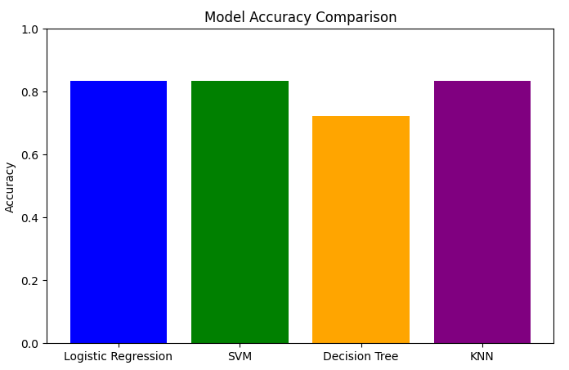
Classification Accuracy
Logistic Regression,SVM and KNN perform both the best.

Slide 41
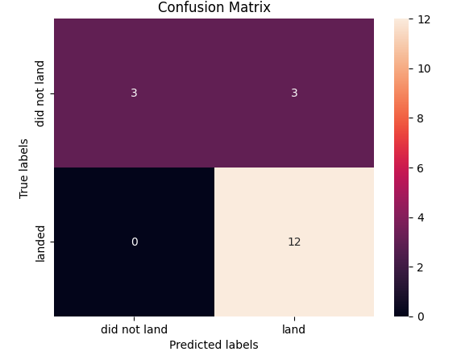
Confusion Matrix of best model
True Positive - 12 (True label is landed, Predicted label is also landed)
False Positive - 3 (True label is not landed, Predicted label is landed)

Slide 42
Conclusions
• In this project, we try to predict if the first stage of a given Falcon 9 launch will land to determine the cost of a launch.
• Each feature of a Falcon 9 launch, such as its payload mass or orbit type, may affect the mission outcome in a certain way.
• Several machine learning algorithms are employed to learn the patterns of past Falcon 9 launch data to produce predictive models that can be used to predict the outcome of a Falcon 9 launch.
• The predictive model produced by logistic regression,SVM and KNN algorithm performed the best.

Slide 43


